Slide 1
B.TECH ECE FINAL YEAR PROJECT SECOND REVIEW
STACKOVERFLOW ASSISTANT CHATBOT USING NLP
TEAM
17BEC0125 – Jasmine Batra
FACULTY GUIDE
Sankar Ganesh S
School Of Electronics Engineering
Assistant Professor (Senior)

Slide 2

CHATBOT A computer program that can talk to humans in natural language. It can understand human language, process it and interact back with humans while performing specific tasks.

Slide 3
C
O
N
T
E
N
T
S
1. Literature Survey
2. Objective
3. Flowchart
4. Hardware/Software Tools
5. Work done so far
6. Methodology
7. Results
8. Work to be done
9. Conclusion
10. Scope for Improvent
11. Timeline
12. References

Slide 4

LITERATURE SURVEY
N. N. Khin and K. M. Soe, "Question Answering based University Chatbot using Sequence to Sequence Model," 2020 23rd Conference of the Oriental COCOSDA International Committee for the Co-ordination and Standardisation of Speech Databases and Assessment Techniques (O-COCOSDA), Yangon, Myanmar, 2020, pp. 55-59.
In the paper, the authors explored the ways of communication through neural network chatbot by using the Sequence to Sequence model with Attention Mechanism based on RNN encoder decoder model.
This chatbot is intended to be used in university education sector for frequently asked questions about the university and its related information.

Slide 5
LITERATURE SURVEY
B. Setiaji and F. W. Wibowo, "Chatbot Using a Knowledge in Database: Human-to-Machine Conversation Modeling," 2016 7th International Conference on Intelligent Systems, Modelling and Simulation (ISMS), Bangkok, 2016, pp. 72-77.
In this paper the machine has been embedded knowledge to identify the sentences and make a decision itself as response to answer a question.
This work uses bigram for sentence similarity calculation which divides input sentence as two letters of input sentence. The higher the score obtained the more is the similarity of reference sentences.
The knowledge of chatbot is stored in the database. The chatbot consists of core and interface that is accessing that core in relational database management systems (RDBMS).

Slide 6
OBJECTIVE
I will create a dialogue Chatbot, which will be able to:
Answer programming-related questions (using StackOverflow dataset)
Chit-Chat and simulate dialogue on all non-programming related questions
The bot will be integrated with Telegram messenger so that we can now talk to this bot in Telegram and it’ll also be hosted on AWS.
The bot will determine the intent and distinguish programming related questions from general ones.
The bot will respond to the programming question asked by tagging it with the corresponding programming language and find the most relevant Stack-Overflow Link.
For general questions, the chatterbot will handle it.

Slide 7
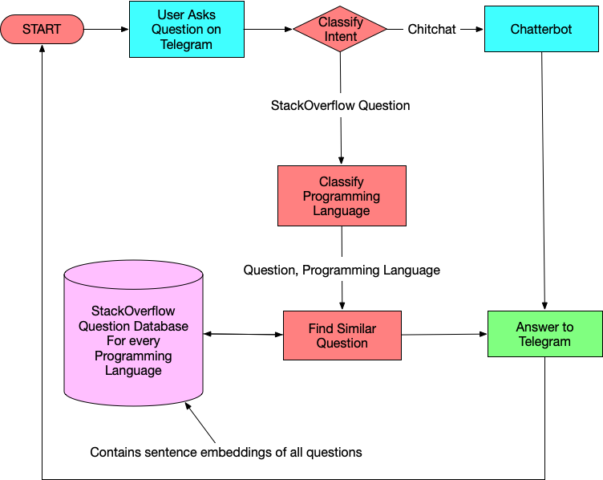
FLOWCHART

Slide 8
HARDWARE/SOFTWARE TOOLS
Dataset
To detect intent of users questions we will use:
dialogues.tsv — dialogue phrases from moves subtitles (negative samples).
tagged_posts.tsv — StackOverflow posts, tagged with one programming language (positive samples).
Resources to build our Chatbot.
GOOGLE COLAB to train the model.
STACKOVERFLOW dataset.
CHATTERBOT, a Python library to generate automated responses to a user’s input for Chitchat type questions for our Chatbot.
TELEGRAM to instantiate the bot, by creating a Chatbot UI and connecting it to telegram app backend and run our Chatbot logic.
AWS to host the Chatbot.

Slide 9
WORK DONE SO FAR
Have created two classifiers and saved them as .pkl files.
Intent-Classifier: This classifier will predict if a question is a Stack-Overflow question or not. If it is not a Stack-overflow question, we let Chatterbot handle it.
Programming-Language(Tag) Classifier: This classifier will predict which language(tag) a question belongs to if the question is a Stack-Overflow question. We do this so we can search for those language questions in our database only.
Have also setup Telegram to make our Chatbot communicate with it using the Access token.

Slide 10
METHODOLOGY
Model Creation
Import Libraries
Import the required libraries.
Read the Data
Read the dataset files and store them as a dataframe.
Create training data for intent classifier
Concatenate dialogue and stackoverflow examples into one sample.
Pre-process texts and split the data into training set and test set in 9:1 ratio.

Slide 11
METHODOLOGY
4. Create Intent classifier
Transform the train set and test set into TF-IDF features.
Do a binary classification on TF-IDF representations of texts
Labels will be either dialogue for general questions or stackoverflow for programming-related questions.
Train the intent recognizer using Logistic Regression on the train set
Check out the accuracy on the test set to check whether everything looks good.
Dump the TF-IDF vectorizer with pickle to use it later in the running bot.
5. Create Programming Language classifier
Prepare the data for this task and split the data into training set and test set in 8:2 ratio.
Reuse the TF-IDF vectorizer that we have already created.
Train the tag classifier using OneVsRestClassifier wrapper over LogisticRegression.
Check out the accuracy on the test set.
Dump the classifier to use it in the running bot.

Slide 12
METHODOLOGY
Telegram Setup
Set up a bot by talking to the BotFather in telegram and creating name/user name for the bot.
Will use main.py to make our Chatbot communicate with Telegram using the access token.
main.py uses BotHandler class that implements all back-end of the bot. It has three main functions:
get_updates - checks for new messages sent by the user.
get_answer - computes the most relevant answer to a user's question using a SimpleDialogueManager class.
send_message – posts the answer computed as a new message to user.

Slide 13
RESULTS
Two classifiers have been created
1. Intent-Classifier that will predict if a question is a chit-chat question or a stack overflow question with a test accuracy of 98.98%. It is saved as intent_clf.pkl in my project repository.
2. Programming-Language Classifier that will predict the language of a stack overflow question with a test accuracy of 80.38%. It is saved as tag_clf.pkl in my project repository.
Telegram has been set up to show how our chatbot responds to simple queries. We also get a dictionary that contains Unique Chat ID, Chat Text, User Information, etc. which we can use as per our requirements later.

Slide 14
WORK TO BE DONE
Store Question database Embeddings
To convert every question to an embedding and store them so we don’t calculate the embeddings for the whole dataset every time.
Whenever user asks a stack overflow question, to use some distance similarity measure to get the most similar question.
In essence, to have a function to get most similar question’s post id in the dataset given we know the programming Language of the question and the question.
Telegram Bot Handler
To fit all the pieces in our SimpleDialogueManagerClass
To integrate ChatterBot that can talk to the user and answer random chit-chat queries in our generate_answer function .
To instantiate all the models, classifiers and TFIDF vectorizer objects that we’ve stored and find index of most similar post using the get_similar_question function for the generate_answer function to respond to Stack Overflow questions

Slide 15
CONCLUSION
In this project, I’ve proposed an approach for designing and building an interactive ChatBot that does question-answering.
The proposed approach includes different classifiers, stored question database embeddings, telegram bot handler and its implementation.
Experimental results show that the selected algorithms are in accordance with the implementation of the ChatBot approach with good test accuracies.
Telegram is used as a frontend medium to ask questions to the bot which then responds back using the trained models in its backend.
The chatbot will assist people in searching for solutions to programming questions that they would need (at work or study), and also hold conversations with the user.

Slide 16
SCOPE FOR IMPROVEMMENT
We can improve on this present chatbot by increasing classifier accuracy, handling edge cases, making it respond faster, or maybe adding more logic to handle more use cases.
For a chit-chat mode we will use a pre-trained neural network engine available from ChatterBot, we can also use Seq-2-Seq models or train our own models to create such bots.
In the near future, we plan to extend our work on a large scale study such as to answer questions from all domains, i.e, open-domain question answering.

Slide 17
TIMELINE
Review-1 (Feb 2021)
Understanding of the project, the objective and tool requirements, formulation of project plan.
Review-2 (Feb-Mar 2021)
Creation of Intent-Classifier and Programming-Language(Tag) Classifier.
Setting up of Telegram to make our Chatbot communicate with it.
Review-3 (Apr-May 2021)
To store question database embeddings to get most similar question for the one the user has asked.
To fit all the pieces in our SimpleDialogueManagerClass in our Telegram Bot Handler

Slide 18
REFERENCES
[1] N. N. Khin and K. M. Soe, "Question Answering based University Chatbot using Sequence to Sequence Model," 2020 23rd Conference of the Oriental COCOSDA International Committee for the Co-ordination and Standardisation of Speech Databases and Assessment Techniques (O-COCOSDA), Yangon, Myanmar, 2020, pp. 55-59.
[2] B. Setiaji and F. W. Wibowo, "Chatbot Using a Knowledge in Database: Human-to-Machine Conversation Modeling," 2016 7th International Conference on Intelligent Systems, Modelling and Simulation (ISMS), Bangkok, 2016, pp. 72-77.
[3] L. T. Hien, L. Tran Thi Ly, C. Pham-Nguyen, T. Le Dinh, H. Tiet Gia and L. N. Hoai Nam, "Towards Chatbot-based Interactive What- and How-Question Answering Systems: the Adobot Approach," 2020 RIVF International Conference on Computing and Communication Technologies (RIVF), Ho Chi Minh, Vietnam, 2020, pp. 1-3, doi: 10.1109/RIVF48685.2020.9140742.
[4] Quarteroni, S. and Manandhar, S., 2007. A chatbot-based interactive question answering system. Decalog 2007, 83.
[5] Mutiwokuziva, M.T., Chanda, M.W., Kadebu, P., Mukwazvure, A. and Gotora, T.T., 2017, October. A neural-network based chat bot. In 2017 2nd International Conference on Communication and Electronics Systems (ICCES) (pp. 212-217). IEEE.

Slide 19
REFERENCES
[6] Ranoliya, B.R., Raghuwanshi, N. and Singh, S., 2017, September. Chatbot for university related FAQs. In 2017 International Conference on Advances in Computing, Communications and Informatics (ICACCI) (pp. 1525-1530). IEEE.
[7] Palasundram, K., Sharef, N.M., Nasharuddin, N., Kasmiran, K. and Azman, A., 2019. Sequence to sequence model performance for education chatbot. International Journal of Emerging Technologies in Learning (iJET), 14(24), pp.56-68.
[8] El Zini, J., Rizk, Y., Awad, M. and Antoun, J., 2019, July. Towards a deep learning question-answering specialized chatbot for objective structured clinical examinations. In 2019 International Joint Conference on Neural Networks (IJCNN) (pp. 1-9). IEEE.
[9] Sreelakshmi, A.S., Abhinaya, S.B., Nair, A. and Nirmala, S.J., 2019, November. A Question Answering and Quiz Generation Chatbot for Education. In 2019 Grace Hopper Celebration India (GHCI) (pp. 1-6). IEEE.
[10] Akhtar, M., Neidhardt, J. and Werthner, H., 2019, July. The potential of chatbots: analysis of chatbot conversations. In 2019 IEEE 21st Conference on Business Informatics (CBI) (Vol. 1, pp. 397-404). IEEE.

Slide 20
THANK YOU

